Slide 1
Attrition Analysis
- Dheeraj Vempaty
Notes:
A finished project is valued much more than an unfinished one done alone.

Slide 2
Objective
Analyze employee data to identify key factors impacting attrition and recommend actionable strategies to improve retention.

Slide 3
Data Cleaning and Preparation
Took a backup of the original table and removed duplicates and non-numeric Employee IDs.
Filtered rows with “NA” while analyzing the Survey ratings vs Attrition for cleaner output.
Joined general_data with survey tables to create a unified dataset.

Slide 4
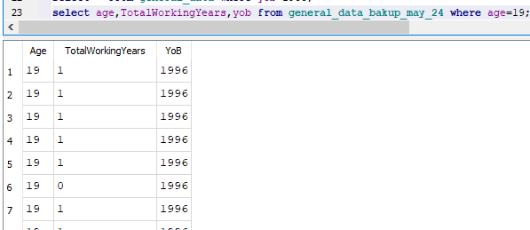
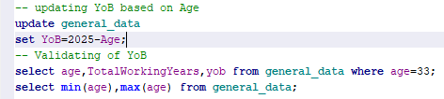
Data Cleaning and Preparation
Derived Fields: Year of Birth (YoB) did not match Age or Experience. Updated YoB based on Age to ensure consistency.

Slide 5
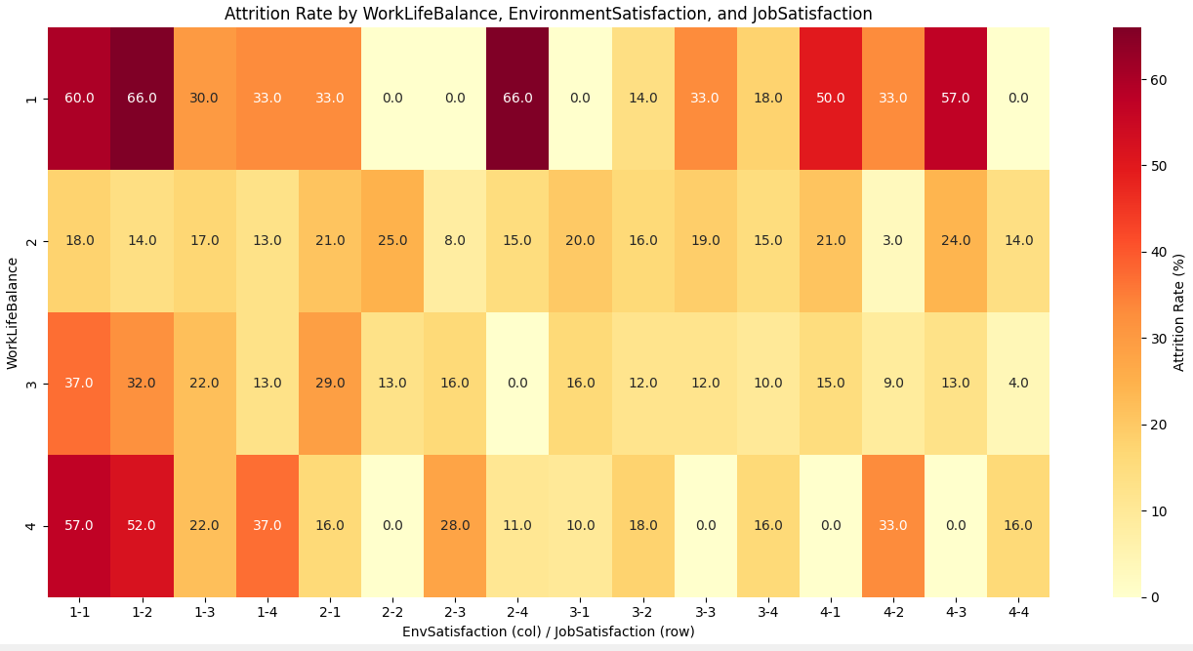

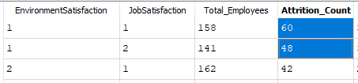
Observations
Survey Feedback :
WorkLifeBalance = 1 showed the highest attrition rate at 31.4%.
EnvironmentSatisfaction = 1 and JobSatisfaction = 1 also show elevated attrition (~25%+).

Slide 6
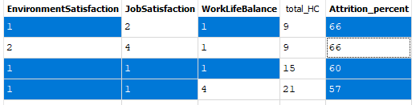
Observations
Survey Feedback :
Attrition spikes when multiple low survey ratings occur together.
Employees with low satisfaction and poor work-life balance are at the highest risk of leaving.

Slide 7
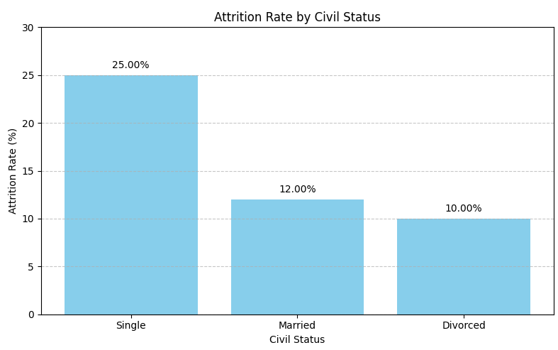
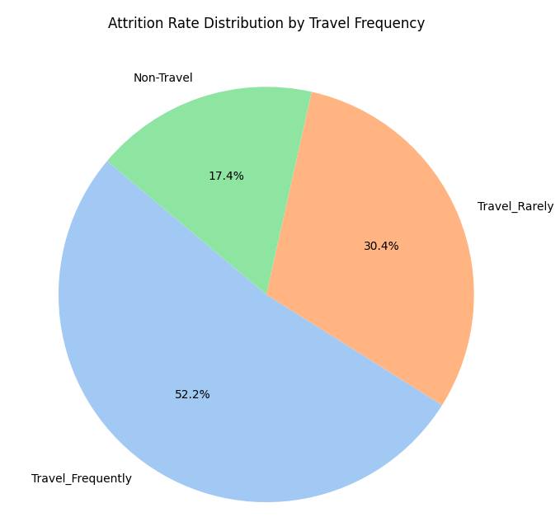
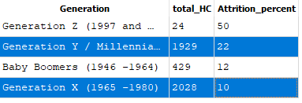
Observations
Demographic & Job Role:
Single employees have a 57% higher attrition rate compared to the overall average(16%), and over 2X higher than married employees.
Generation Y (Millennials) are more likely to leave than Generation X.
Frequent travelers show higher attrition rate than those who travel rarely.

Slide 8
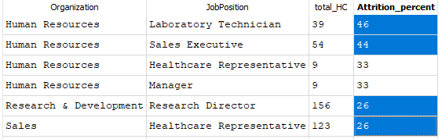
Observations
Demographic & Job Role:
Human Resources department shows particularly high attrition in technician/sales roles.
R&D roles, like Research Director, show significant attrition.

Slide 9
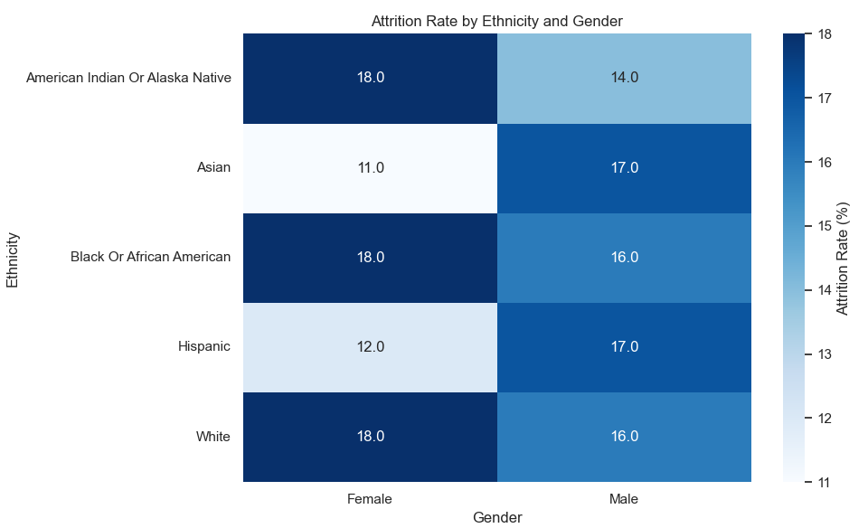
Observations
Ethnicity & Gender:
Minor differences exist across ethnicity and gender groups, they do not significantly drive attrition compared to work experience, role dynamics, and employee satisfaction.

Slide 10
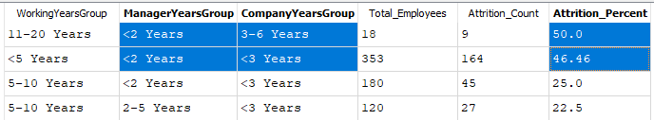
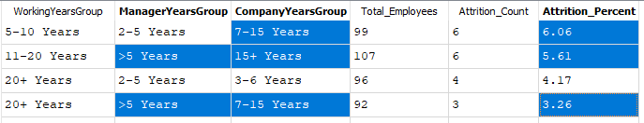
Observations
Years of Experience:
Employees with <2 years under their manager face attrition rates up to 50%.
Employees with longer tenure at the company and stable manager show much lower attrition.

Slide 11
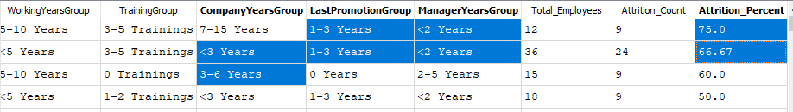
Observations
Years of Experience:
Shorter tenure with the company and manager, especially when combined with recent promotions significantly increases Attrition risk.
Salary/Stocks/Hike:
Salary is not a strong retention lever—non-monetary factors dominate.
High salary or large raises do not guarantee retention.

Slide 12
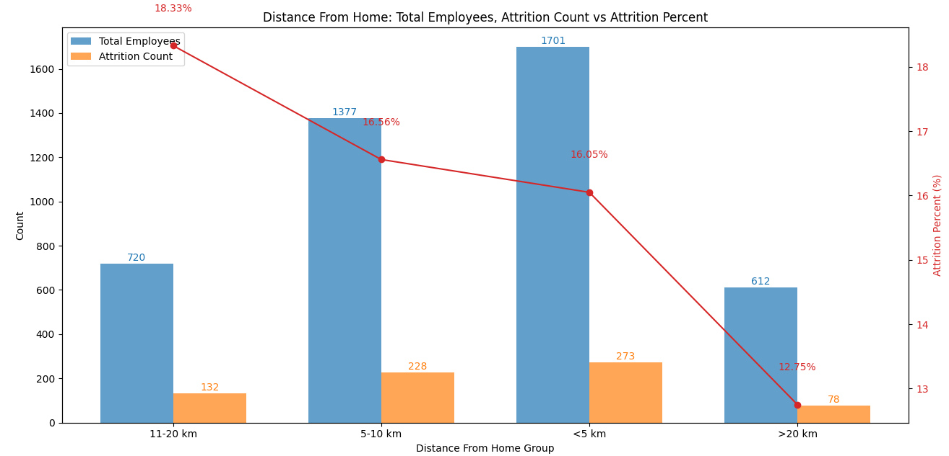
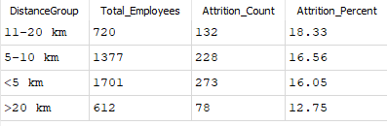
Observations
Commute to Office:
Majority of employees live within 5 km of the office, and attrition rates for those with short (<5 km) or mid-range (5–20 km) commutes are comparable, ranging between 16%–18%.
This suggests that Proximity to office has minimal influence on attrition (~16–18% regardless of distance).

Slide 13
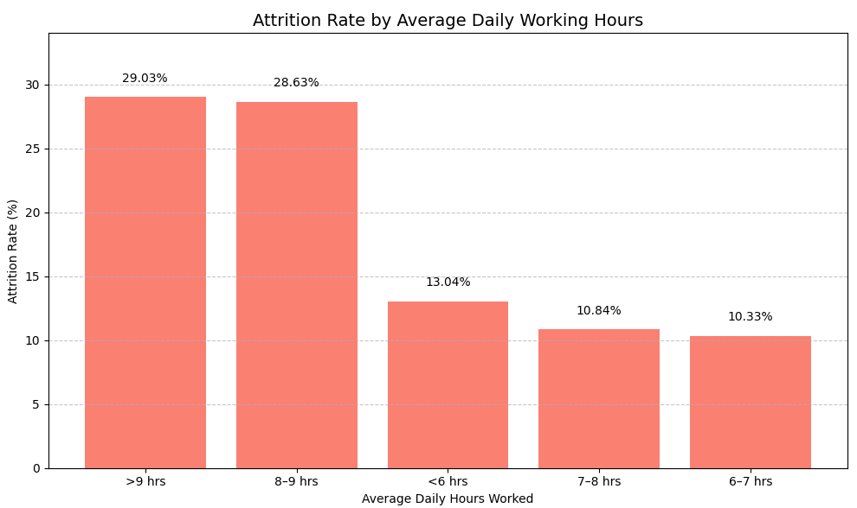
Observations
Time Spent in Office:
Employees working >8 hours per day have a much higher attrition rate (~29%).
Those working a balanced 6–8 hours per day show the lowest attrition (~10%).

Slide 14
Insights Summary
Poor Work-Life Balance (31.4% attrition)
Low Environment/Job Satisfaction (25–26%)
Short Tenure with Manager & Recent Promotions (<2 years → up to 50%)
Frequent travelers show more attrition than rare or non-travelers
High Working Hours (>8 hrs/day → 29%)
Salary, Ethnicity, Gender and Office Commute Distance are not strong drivers of attrition.

Slide 15
Recommendations
Work-Life Balance: Roll out flexible schedules or hybrid models.
Targeted Engagement: Focus retention programs on Millennials and single employees.
Support Early-Stage Manager Relationships (<2 years) to reduce 50%+ attrition risk.
Monitor & Manage High-Risk Roles – Some roles have 20%+ attrition despite good compensation.

Slide 16
Data Enhancements for Better Attrition Insights
Few high-value dimensions to add on current dataset for strengthen insights, KPIs, and decision-making:
Attrition Type - Voluntary vs. Involuntary
Exit Reason - Better offer, relocation, manager issues, burnout etc.,.
Team Size / Span of Control
Retention Risk

